Slide 1
REST and Web API’s
Steven Suing, MCSD – Practice Manager
@stsuing
www.stevensuing.com
Notes:
Title
Raleigh Office
What are you working on
Why I care about this topic
Abstract of the talk
Who is writing API’s and how did they communicate it.

Slide 2
What is REST
Representational State Transfer
A Style of software architecture for distributed systems
Web is Based on this
Used to gain the broadest reach possible.
Notes:
How many people consumed an API this year. What was that like

Slide 3
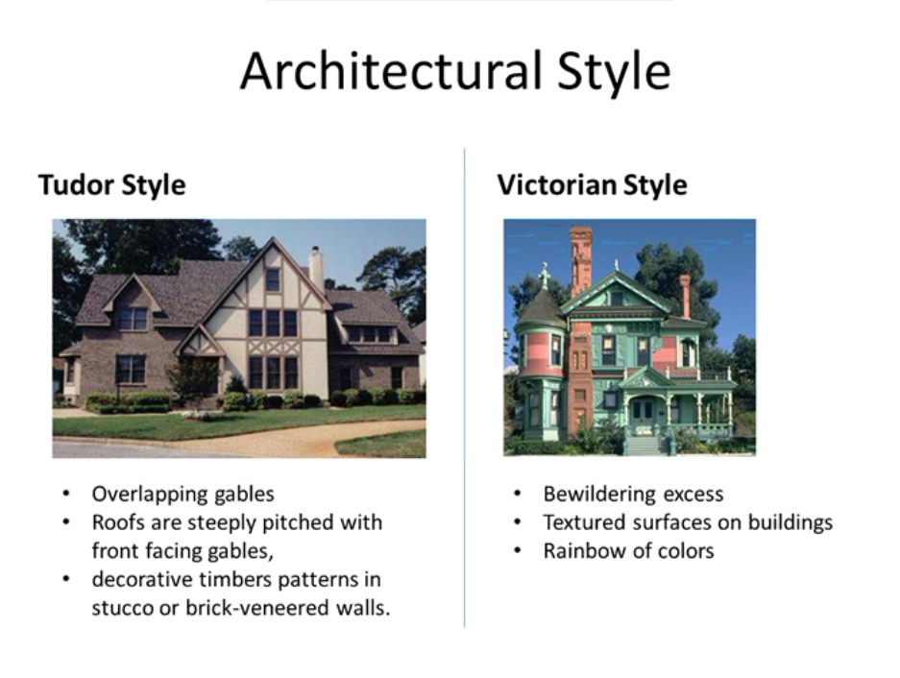
REST as an Architectural pattern
REST Style – {what to care about}
Uniform interface
Client Server
Stateless
Notes:
How many people consumed an API this year. What was that like

Slide 4
What is the WCF Web API
.Net framework targeting the http Protocol to enable REST style architecture

Slide 5
Demo
Web Api – Hello World

Slide 6
SOAP vs HTTP+JSON
SOAP
Doesn’t conform to HTTP Standards
Massive interoperability problems
WSDL describes custom service in a strongly types way
HTTP+JSON
Based on HTTP Standards
Made to interoperate.
Services are described using Documentation.
Just do something that works.
Notes:
How many people consumed an API this year. What was that like

Slide 7
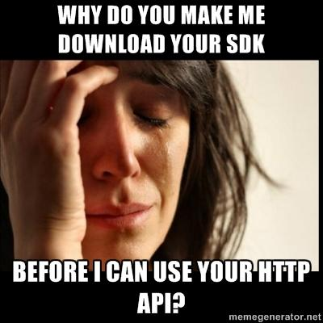
HTTP Api’s and SDK’s
- Mike Amundsen
Notes:
Prescribing a usage path Not allowing Discoverability of API
Potentially tightly binding client and server.

Slide 8
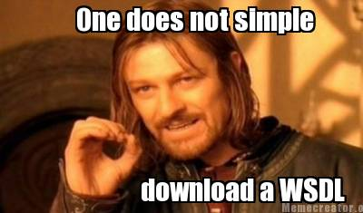
Creating a proxy for a HTTP+POX service

Slide 9
How then
Documentation
Keep Dev’s interested in your product.
Give developers what they need
React by improving your documentation
reducing support costs
Leads to a loose coupling between client and server
Some Standardization –
IANA Media Types
HTTP

Slide 10
Elements of a good API Documentation
Overview
Getting Started
Examples
Reference

Slide 11
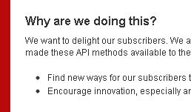
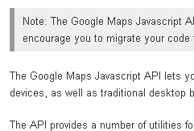
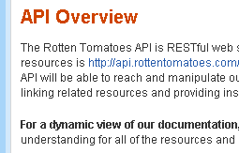
Elements of a good API Documentation
Overview

Slide 12
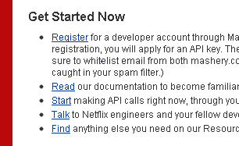
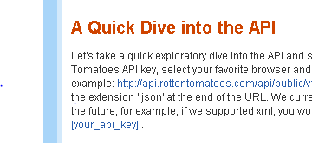
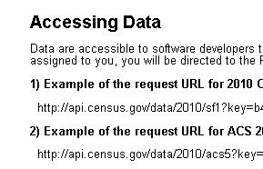
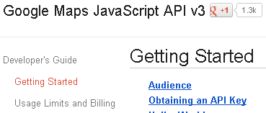
Elements of a good web API.
Getting Started
Netflix
RottenTomatos
Census
Google

Slide 13
Elements of a good web API
Getting Started components
Everything needed for Hello World
Security Consideration
High Level Information about working with API
Sample Hello World Code

Slide 14
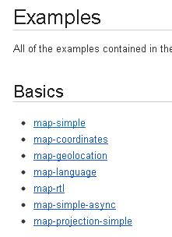
Elements of a good web API.
Samples and Examples
For example: http://api.rottentomatoes.com/api/public/v1.0.json?apikey=[your_api_key] Replace [your_api_key] with your own API key.
Census
1) Example of the request URL for 2010 Census SF1 data that has an assigned key inserted:
http://api.census.gov/data/2010/sf1?key=b48301d897146e8f8efd9bef3c6eb1fcb864cf&get=P0010001,NAME&for=state:*

Slide 15
Elements of a good web API.
Reference – the details of the API
Catalog of all service calls
For each service Call
Supported Media Types
Example Request and Response in each Media type
Business meaning for each service
Error codes and Meaning
Any possible State Transitions
Meta Data used to create Proxy - ??What does that Mean??

Slide 16
Demo

Slide 17
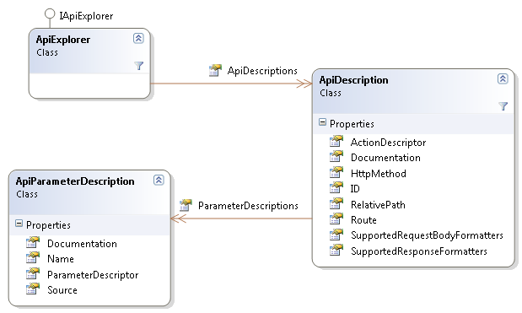
APIExplorer
Produce a collection of ApiDescription
ApiDescription contains basic information such as the HttpMethod, the RelativePath, the Documentation

Slide 18
Examples
http://www.programmableweb.com/apilist
http://www.twilio.com/docs/index
Netflix - http://developer.netflix.com/
IMDB - http://www.omdbapi.com/
Meetup - http://www.meetup.com/meetup_api/docs/2/categories/
Census Data - http://www.census.gov/developers/
Google - http://code.google.com
Stack Exchange - http://api.stackoverflow.com/1.0/usage
Rotten Tomato's - http://developer.rottentomatoes.com/docs

